Slide 1



AtliQ
Hospitality
Analysis
~ Rupal Kanchan
Data Analyst Intern

Slide 2


Problem Statement
Atliq Grands owns multiple five-star hotels across India. They have been in the hospitality industry for the past 20 years.
Due to strategic moves from other competitors and ineffective decision-making in management, Atliq Grands are losing its market share and revenue in the luxury/business hotels category. As a strategic move, the managing director of Atliq Grands wanted to incorporate “Business and Data Intelligence” in order to regain their market share and revenue.

Slide 3

DATA IMPORT: First I gathered data from UNIFIED MENTORS and imported it into Power BI for data transformation.
DATA TRANSFORMATION: Used Power Query to clean the data, removed nulls and duplicates, and fine-tuned data types.
DATA LOADING AND MODELLING: Imported the transformed data into Power View for analysis. After completing the necessary cleaning, and transformation, I create the necessary relationships between the tables.
DATA IMPLEMENTATION: I used different DAX functions to create calculated measures and columns, refining the data for deeper insights.
REPORTS CREATION: First I designed a theme for my report from canva and then imported it to Power BI. After that, I Crafted a user-friendly report/dashboard that helps the organization make important decisions.
Solution
Data Preparation
List 1-3 ways your company proposes to solve them.

Slide 4
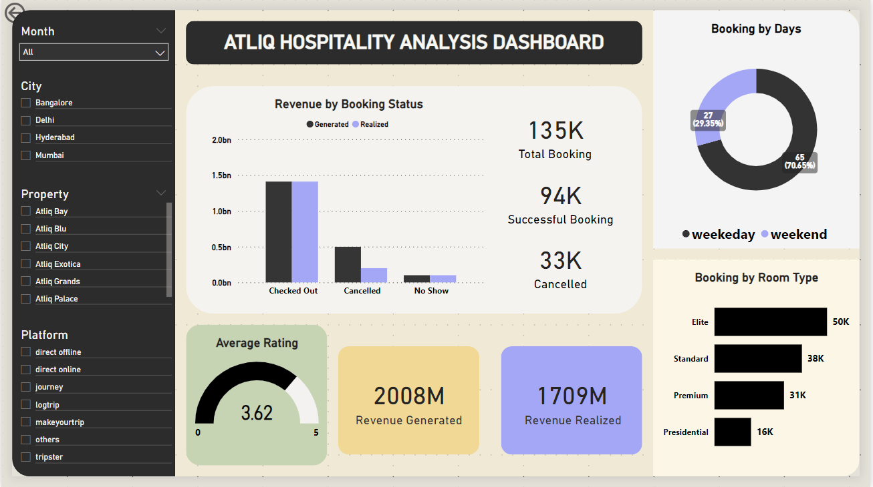
Dashboard Snippet

Slide 5
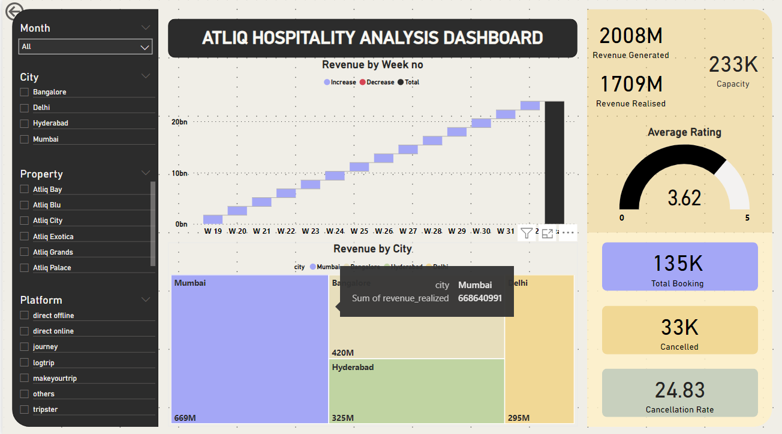
Dashboard Snippet

Slide 6
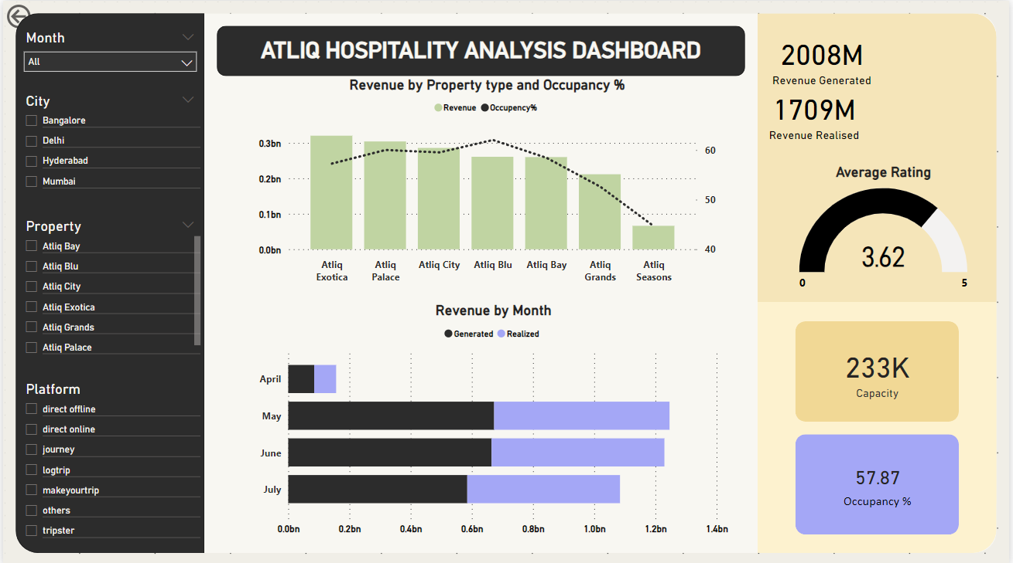
Dashboard Snippet

Slide 7

Filters Used
Month: Allows selection of data for specific months.
City: Filters data based on the city (Bangalore, Delhi, Hyderabad, Mumbai).
Property: Filters data by property (Atliq Bay, Atliq Blu, Atliq City, Atliq Exotica, Atliq Grands, Atliq Palace).
Platform: Filters data based on the booking platform (direct offline, direct online, journey, logtrip, makeyourtrip, others, tripster).

Slide 8



Insights Drawn
Revenue: Shows the total revenue generated and realized (1709M).
Total Booking: Displays the total number of bookings (135K).
Average Rating: Gauge indicating the average rating of the properties (3.62 out of 5).
Capacity: Total capacity across all properties (233K).
Successful Booking: Shows the number of successful bookings (94K).
Occupancy Percentage: Indicates the proportion of available rooms that are being occupied over a specific period (57.87%).
Total Cancelled Bookings: Indicates the number of cancelled bookings (33K).
.

Slide 9
Thank You!!

